Slide 1
Crime Catch
Barkha Samyani 001417278
Lakshit Talreja 001475200
Rishi Jatania 001449023
Shreya Nilengekar 001444235

Slide 2
Problem Statement
This Project focuses on crime reporting system in the city of Boston.
It allows the user to login/register, set emergency contact, get updated with real-time news regarding various events, see various forms of visualizations of data in the forms of charts and maps.
The police can verify the login of user or can delete the user .
We use JWT token, Angular Google Maps and ChartJS.

Slide 3
Technical Specifications
User Data and crime data is stored in mongoDb Atlas
Passport.js for authentication of the user on Node server
Angular Material Design has been used for defining forms and validations.
Angular Https Interceptor for adding JWT token in each outgoing request if present
Angular auth Guard for route protection.
Angular Google maps for plotting various crimes
Chart.js is used for plotting the charts on the page using the existing datasets
NewsAPI has been tailored to get user inputs to provide custom search results.
NodeMailer has been used to provide a SOS alert to the emergency contact of the user.

Slide 4
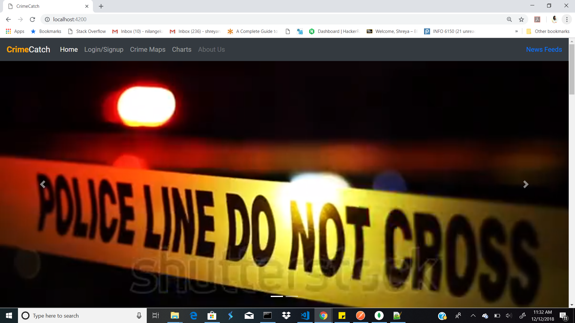

Slide 5
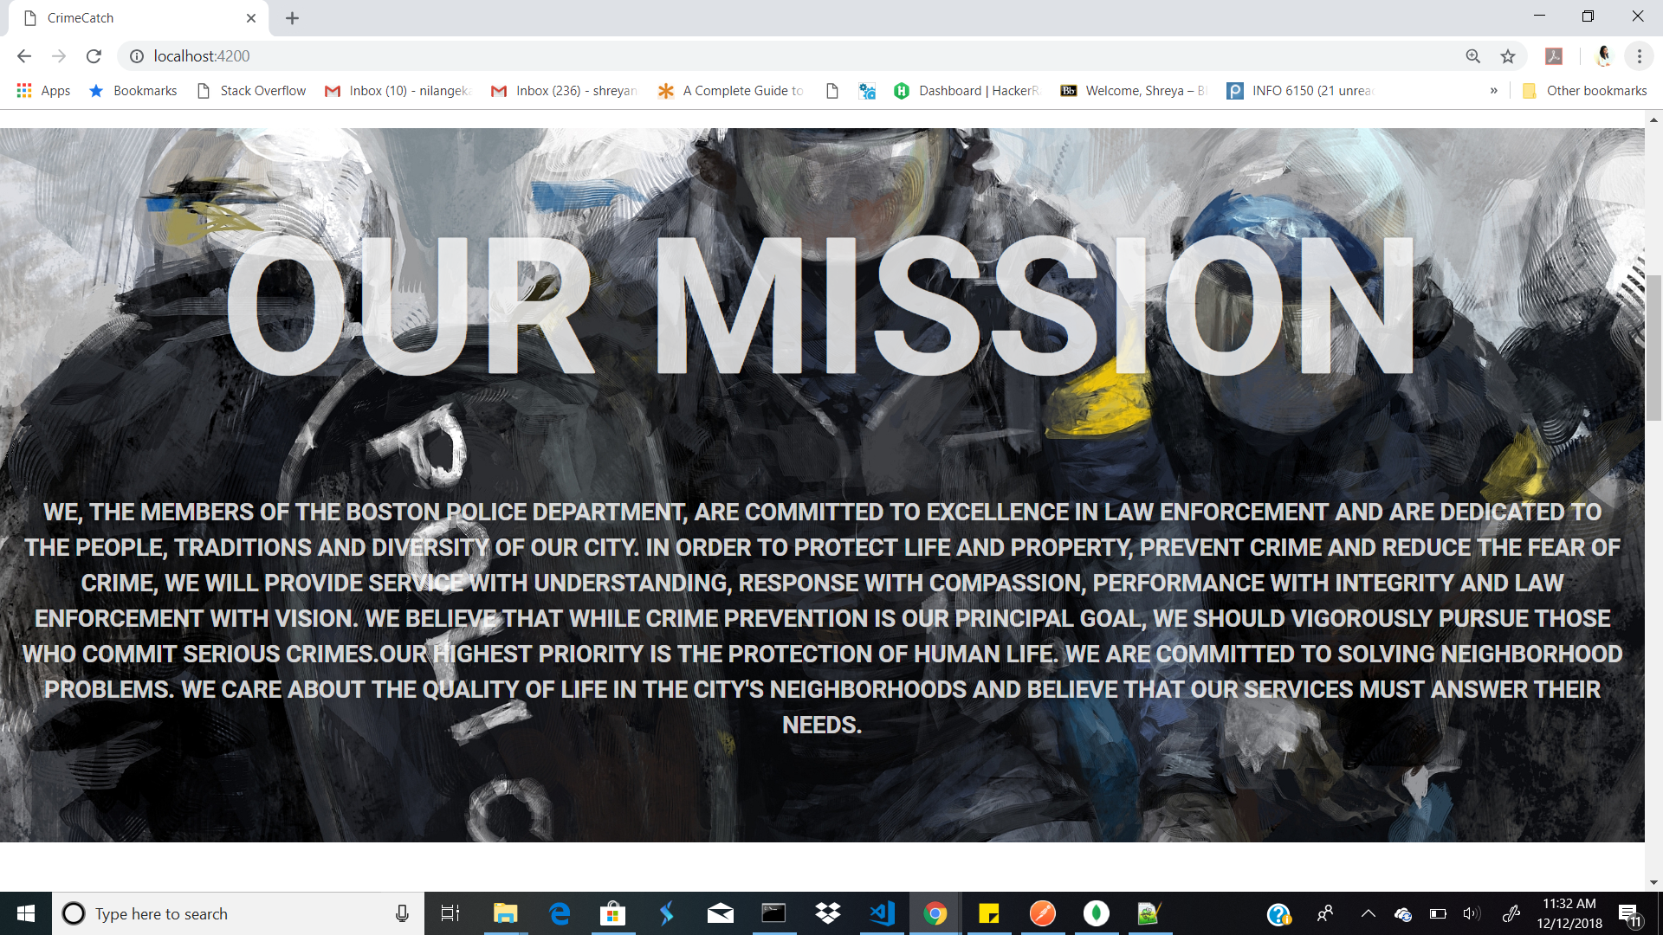

Slide 6
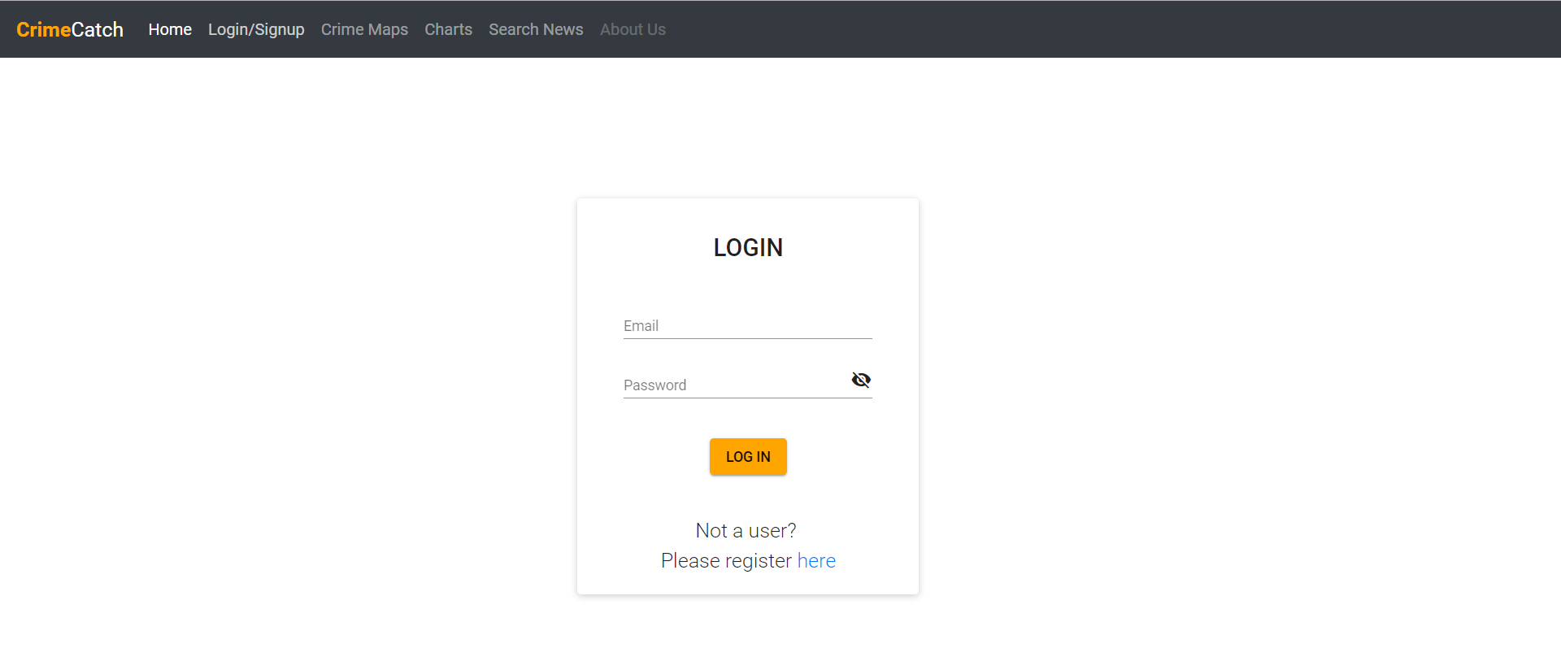

Slide 7
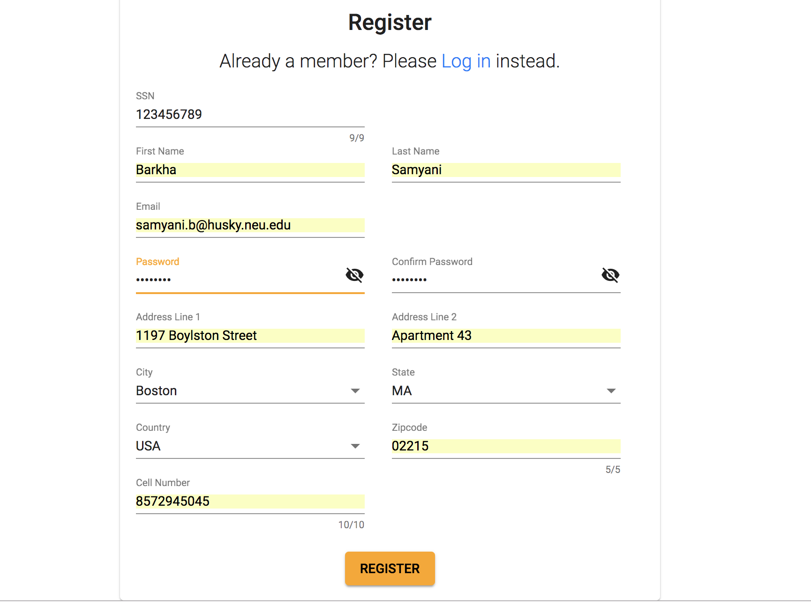

Slide 8
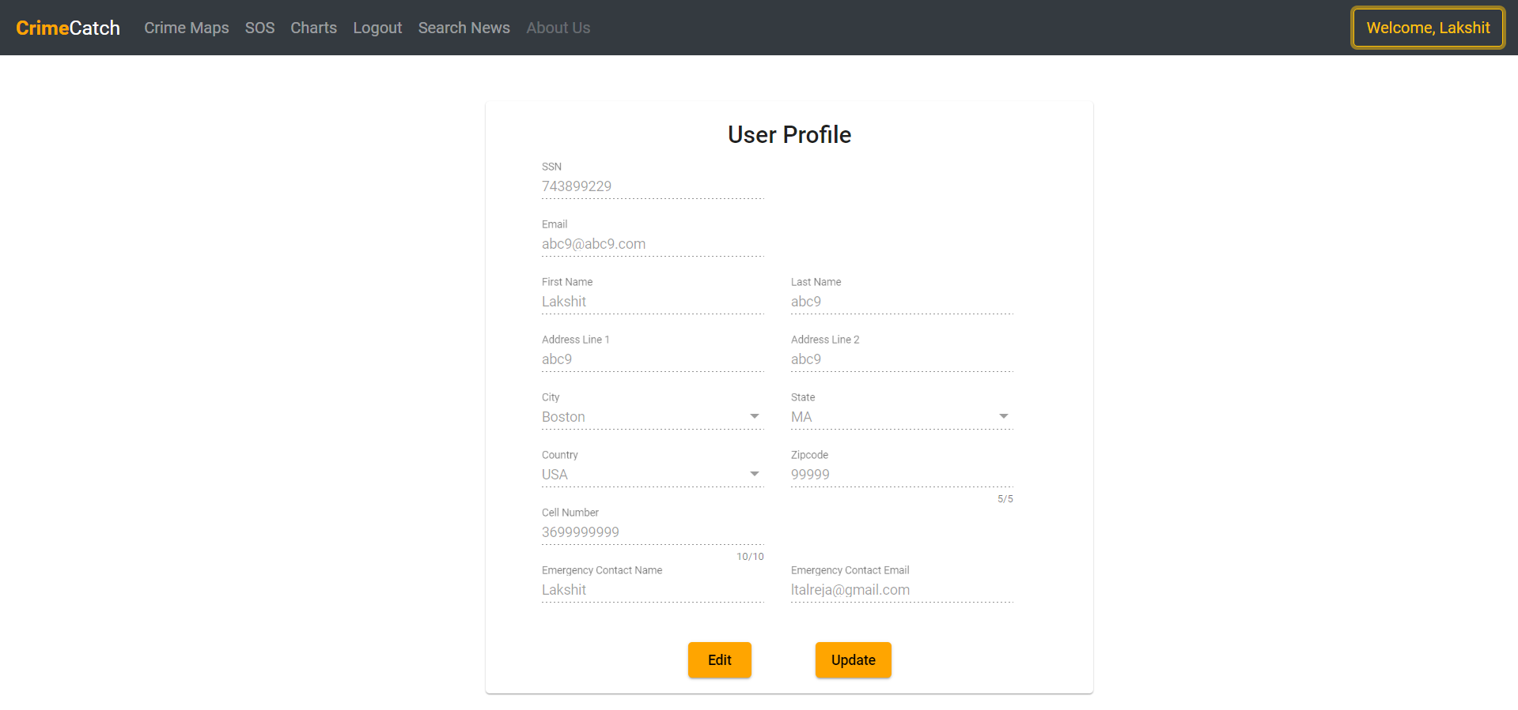

Slide 9
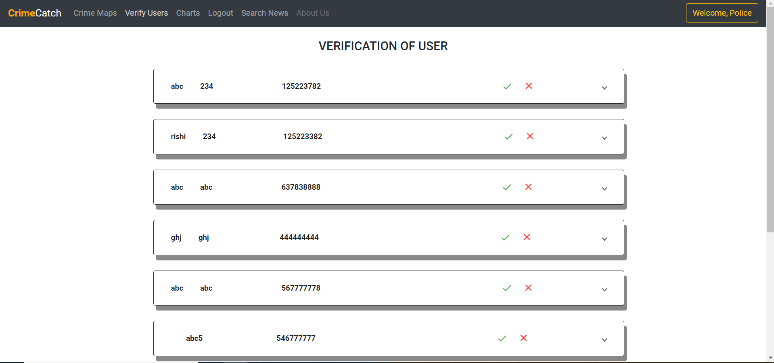

Slide 10
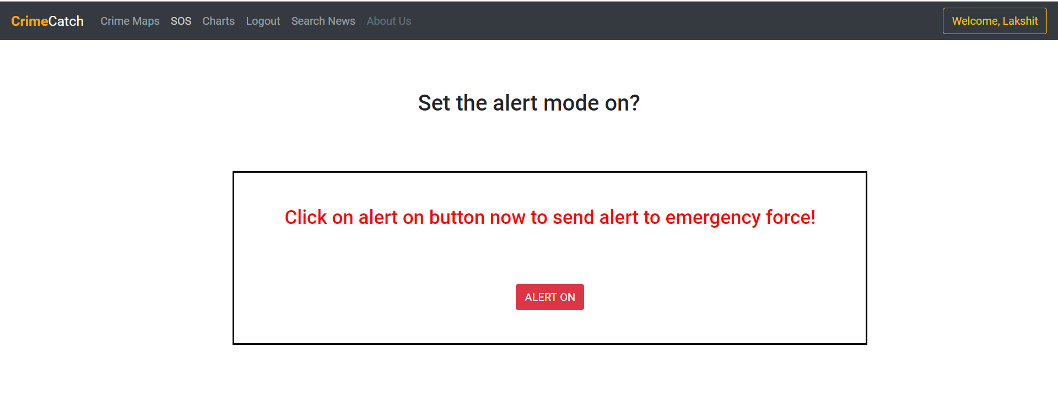
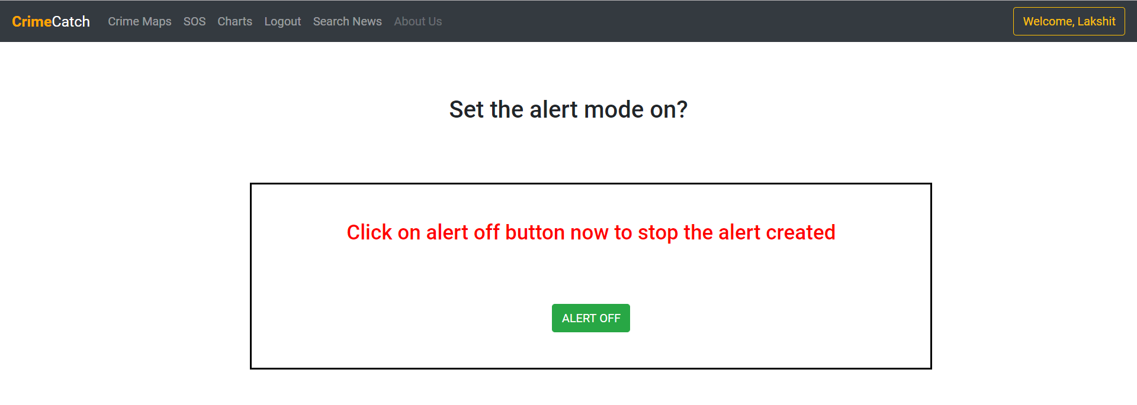
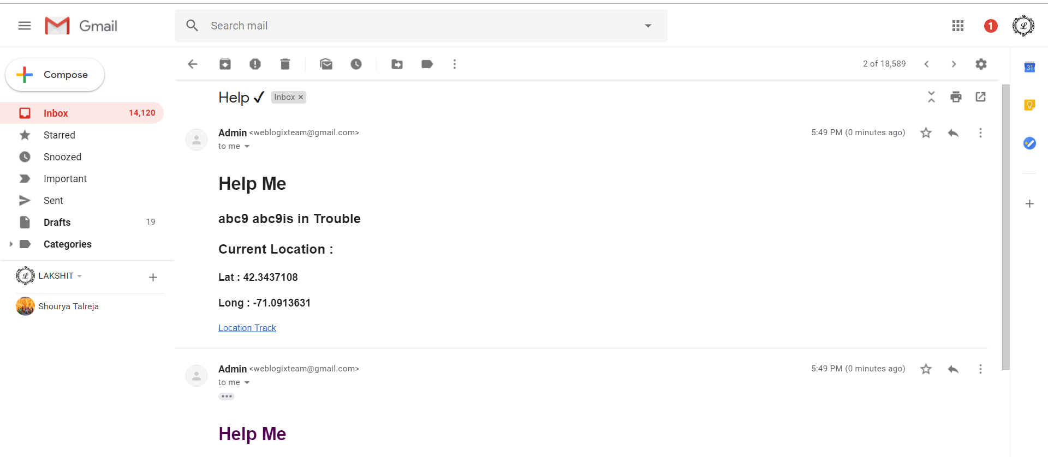

Slide 11
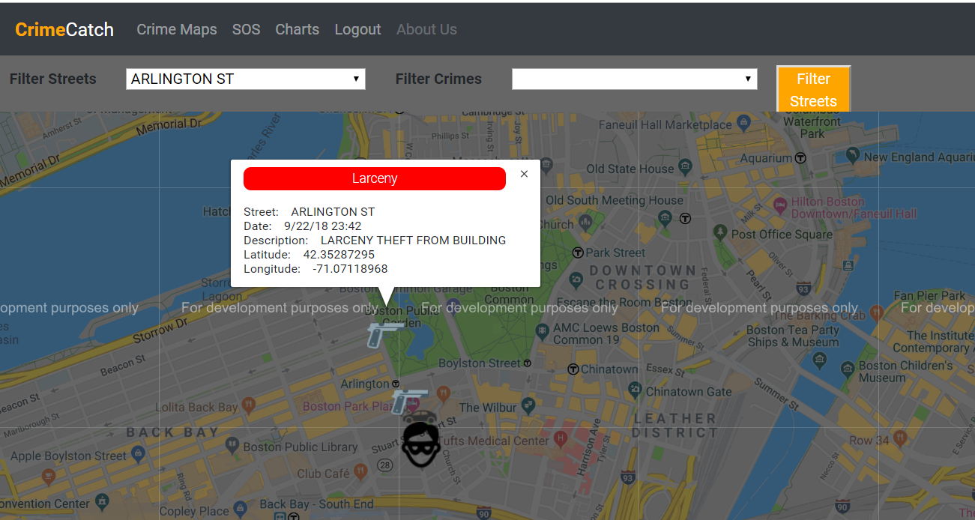

Slide 12
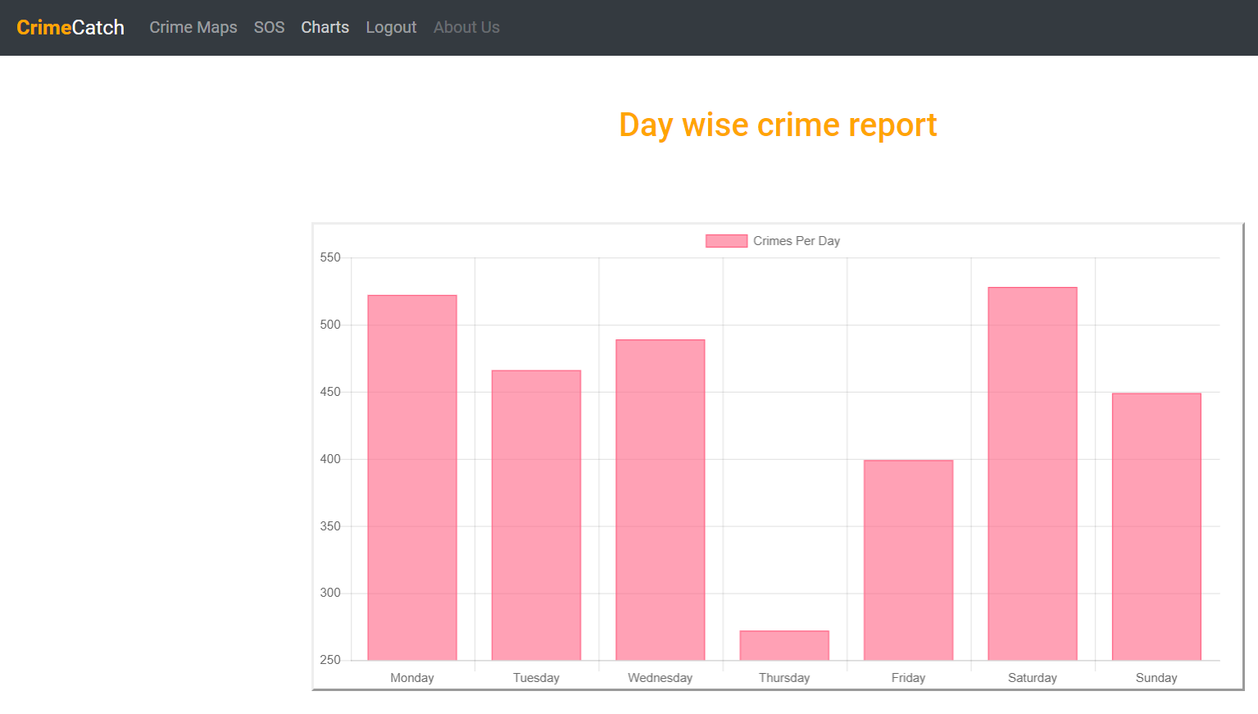

Slide 13
